Slide 1
RE 3: Propensity Scores
UIUC ECON 474 Econometrics of Policy Evaluation

Slide 2
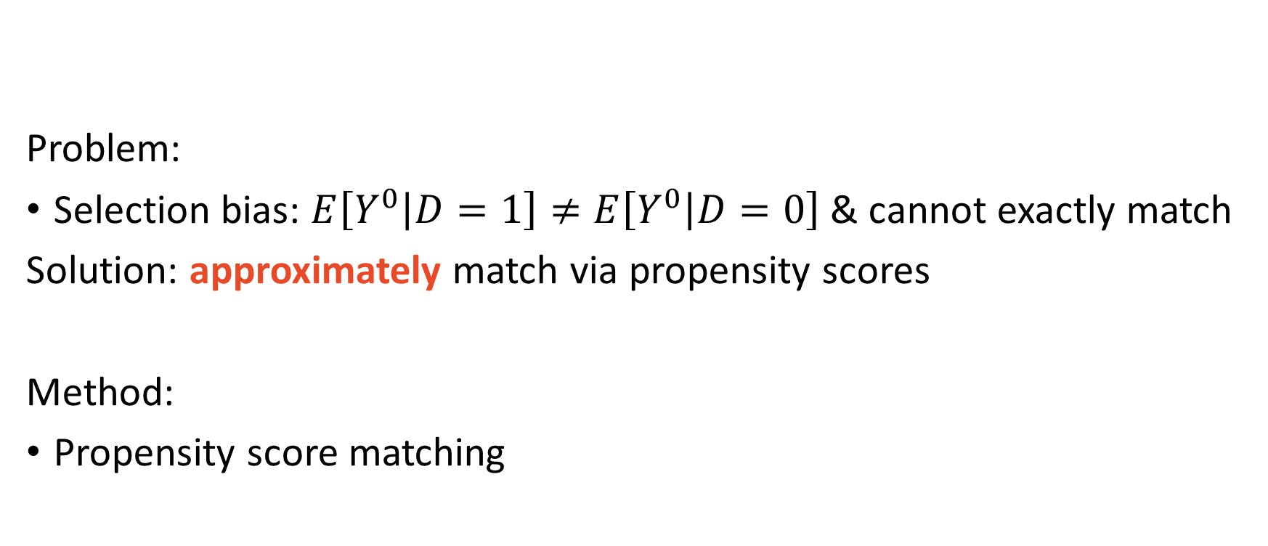
Today
Problem:
Selection bias: $E\left[Y^{0} | D=1\right]≠E\left[Y^{0} | D=0\right]$ & cannot exactly match
Solution: approximately match via propensity scores
Method:
Propensity score matching

Slide 3
Propensity Scores
The probability of being treated

Slide 4
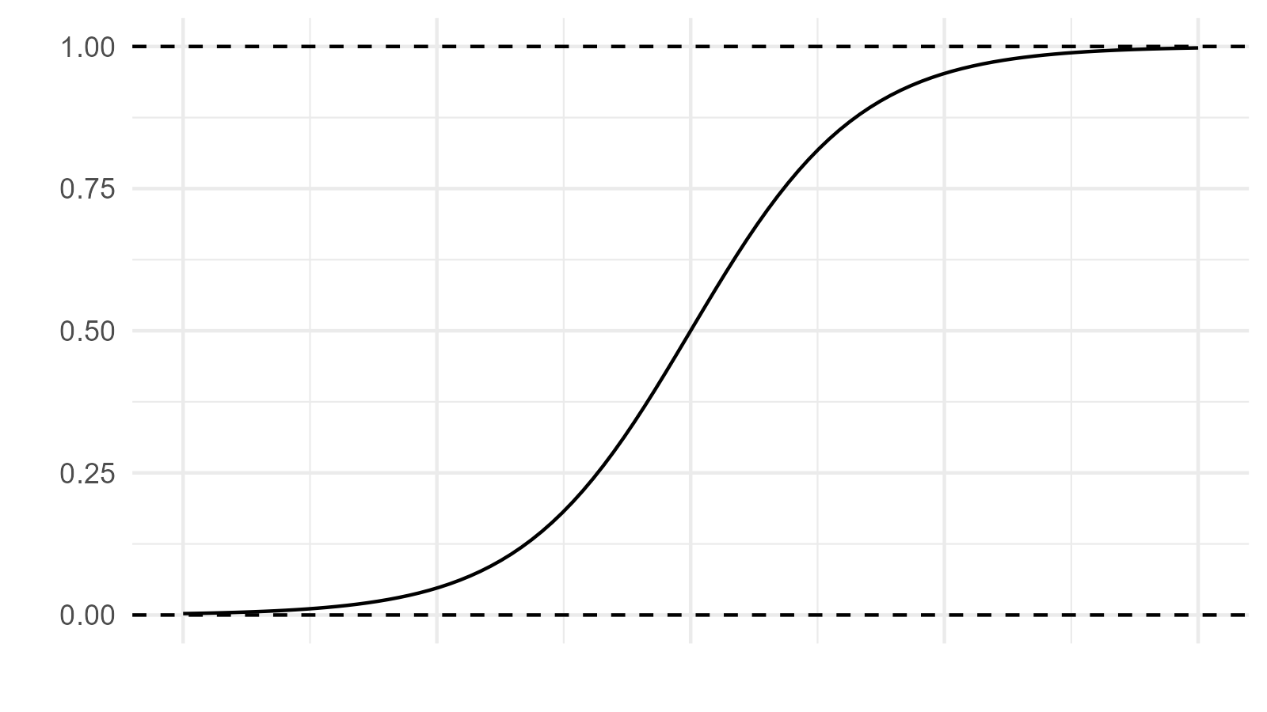
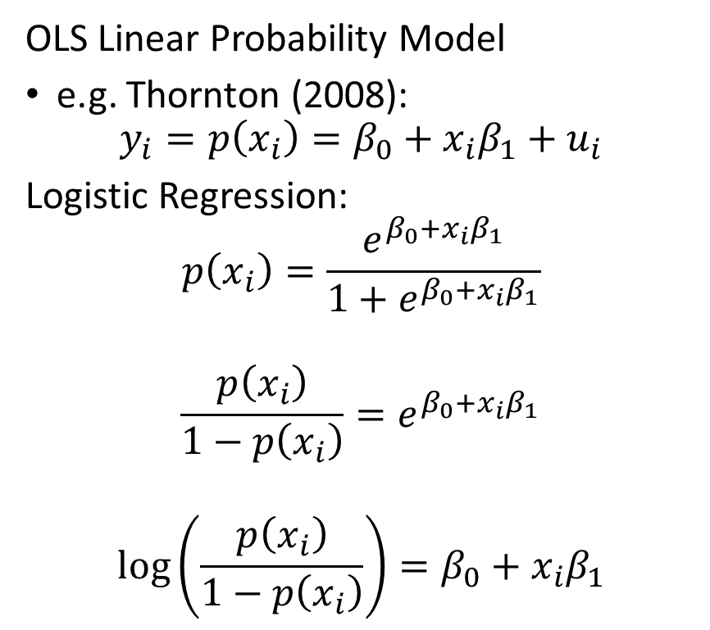
Predicting Discrete Outcomes: $y_{i}∈\{0,1\}$
OLS Linear Probability Model
e.g. Thornton (2008):
$$y_{i}=p\left(x_{i}\right)=β_{0}+{x_{i}β}_{1}+u_{i}$$
Logistic Regression:
$$p\left(x_{i}\right)=\frac{e^{β_{0}+{x_{i}β}_{1}}}{1+e^{β_{0}+{x_{i}β}_{1}}}$$
$$\frac{p\left(x_{i}\right)}{1−p\left(x_{i}\right)}=e^{β_{0}+{x_{i}β}_{1}}$$
$$log\left(\frac{p\left(x_{i}\right)}{1−p\left(x_{i}\right)}\right)=β_{0}+{x_{i}β}_{1}$$

Slide 5
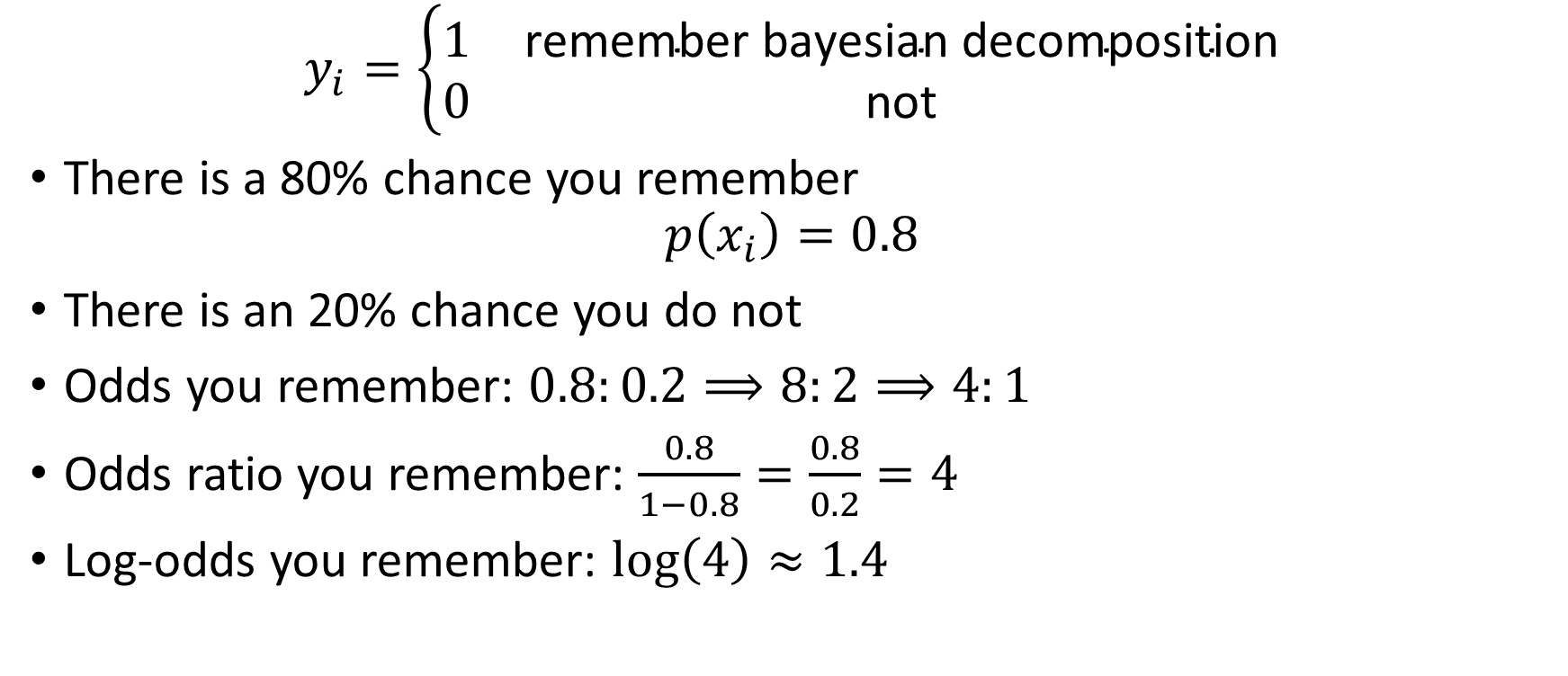
Log-odds
$$y_{i}=\left\{\begin{matrix}1 & \text{remember} \text{bayesian} \text{decomposition} \\ 0 & \text{no}\text{t}\end{matrix}\right.$$
There is a 80% chance you remember
$$p\left(x_{i}\right)=0.8$$
There is an 20% chance you do not
Odds you remember: $0.8:0.2⟹8:2⟹4:1$
Odds ratio you remember: $\frac{0.8}{1−0.8}=\frac{0.8}{0.2}=4$
Log-odds you remember: $\log\left(4\right)≈1.4$

Slide 6
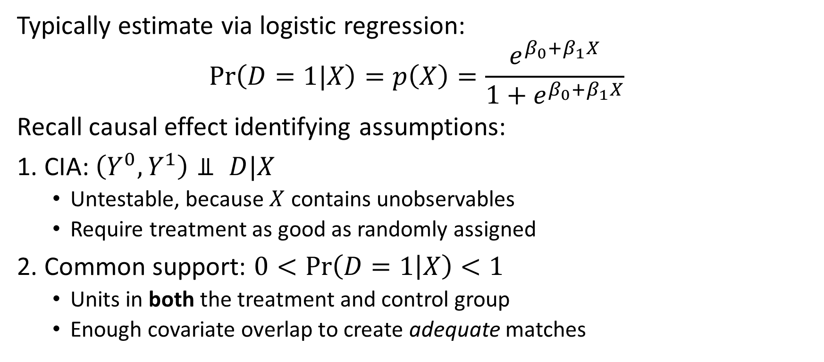
Propensity Scores
Typically estimate via logistic regression:
$$\operatorname{Pr}\left(D=1|X\right)=p\left(X\right)=\frac{e^{β_{0}+β_{1}X}}{1+e^{β_{0}+β_{1}X}}$$
Recall causal effect identifying assumptions:
1. CIA: $\left(Y^{0},Y^{1}\right)⫫ D|X$
Untestable, because $X$ contains unobservables
Require treatment as good as randomly assigned
2. Common support: $0<\operatorname{Pr}\left(D=1 | X\right)<1$
Units in both the treatment and control group
Enough covariate overlap to create adequate matches

Slide 7
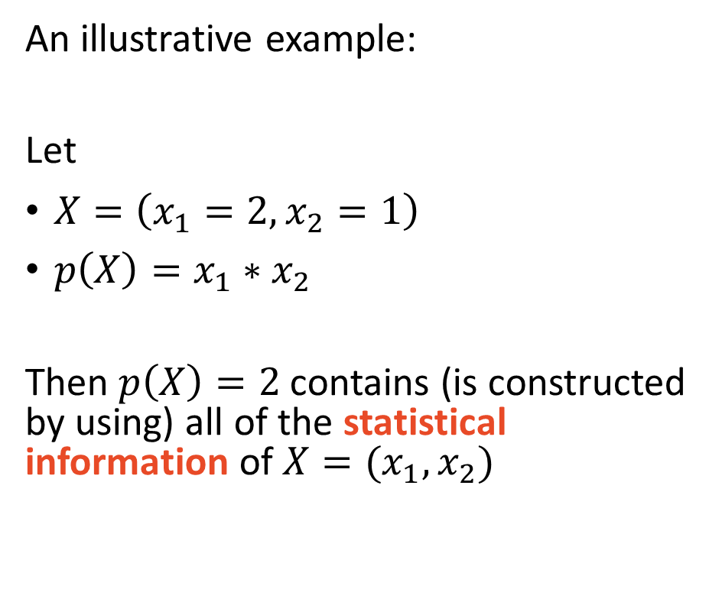
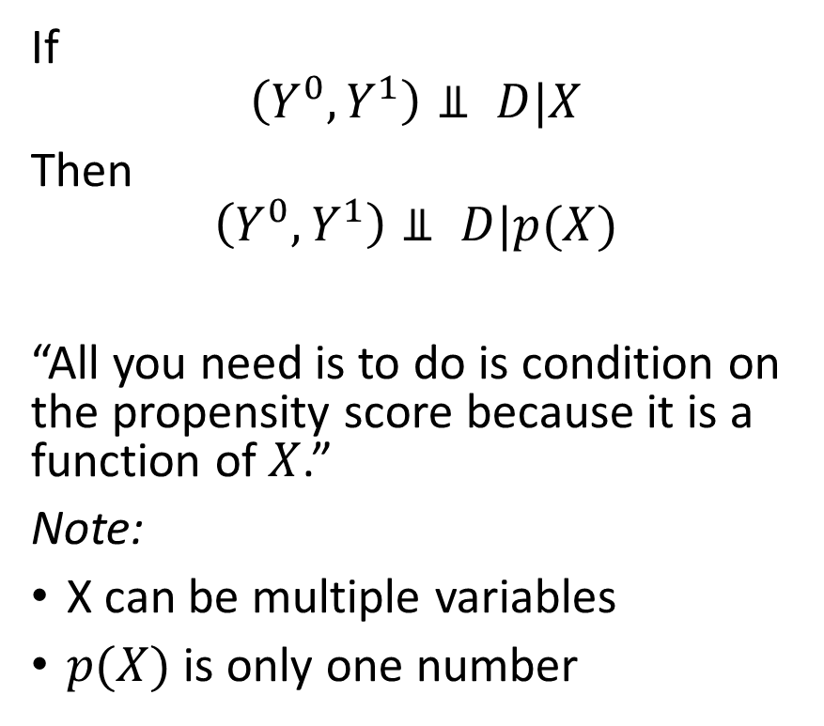
Propensity Score Theorem (PST)
If
$$\left(Y^{0},Y^{1}\right)⫫ D|X$$
Then
$$\left(Y^{0},Y^{1}\right)⫫ D|p(X)$$
“All you need is to do is condition on the propensity score because it is a function of $X$.”
Note:
X can be multiple variables
$p(X)$ is only one number
An illustrative example:
Let
$X=\left(x_{1}=2,x_{2}=1\right)$
$p\left(X\right)=x_{1}∗x_{2}$
Then $p\left(X\right)=2$ contains (is constructed by using) all of the statistical information of $X=(x_{1},x_{2})$

Slide 8
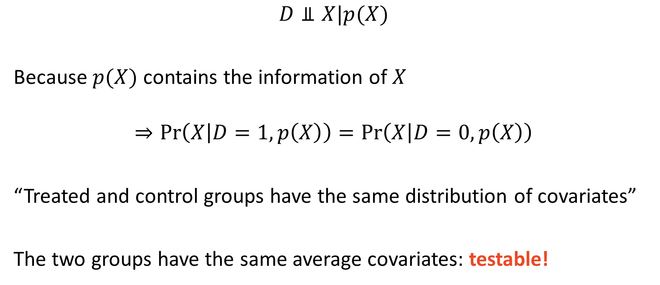
PST Balancing Property
$$D⫫X|p(X)$$
Because $p(X)$ contains the information of $X$
$$⇒\operatorname{Pr}\left(X | D=1,p\left(X\right)\right)=\operatorname{Pr}\left(X | D=0,p\left(X\right)\right)$$
“Treated and control groups have the same distribution of covariates”
The two groups have the same average covariates: testable!

Slide 9
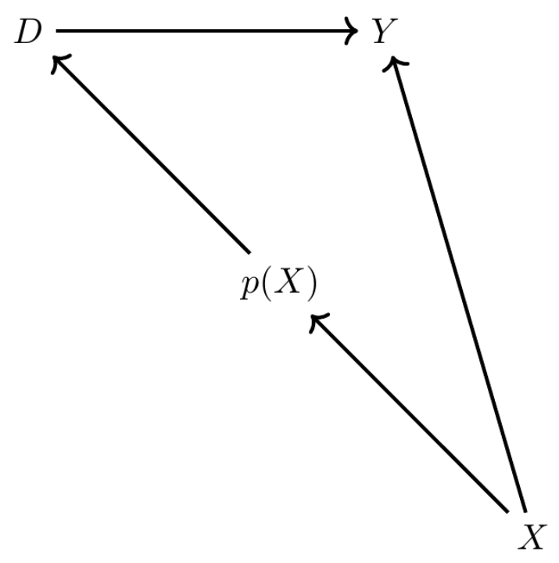
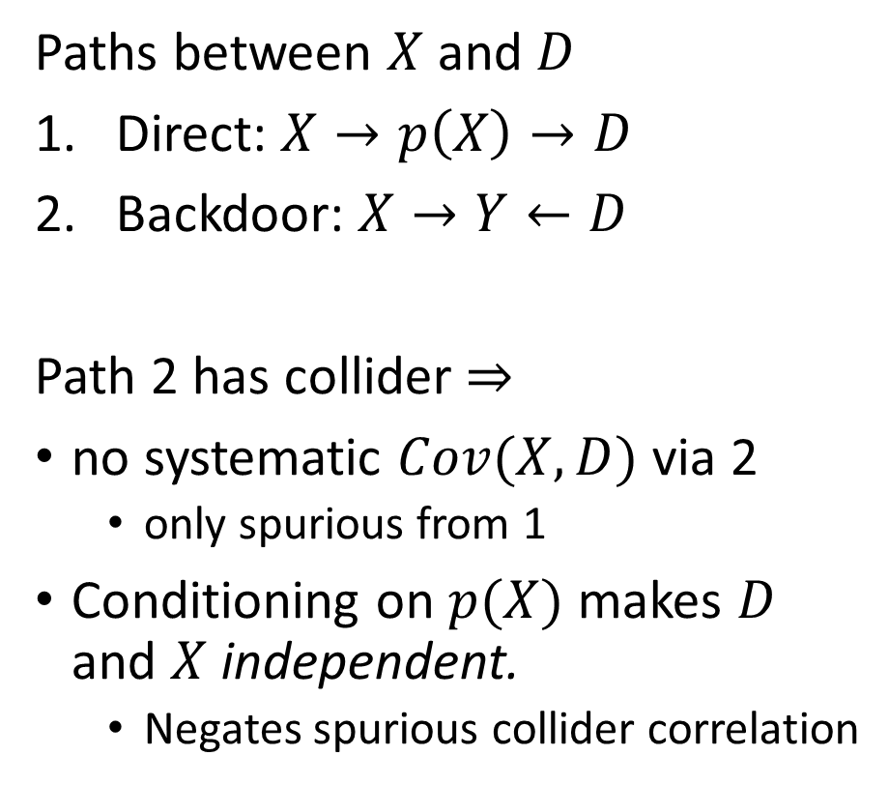
Dagnabbit, another DAG!
Paths between $X$ and $D$
Direct: $X→p\left(X\right)→D$
Backdoor: $X→Y←D$
Path 2 has collider $⇒$
no systematic $Cov(X,D)$ via 2
only spurious from 1
Conditioning on $p(X)$ makes $D$ and $X$ independent.
Negates spurious collider correlation

Slide 10

Propensity Score Matching
Match treated with $n$ nearest neighbors

Slide 11
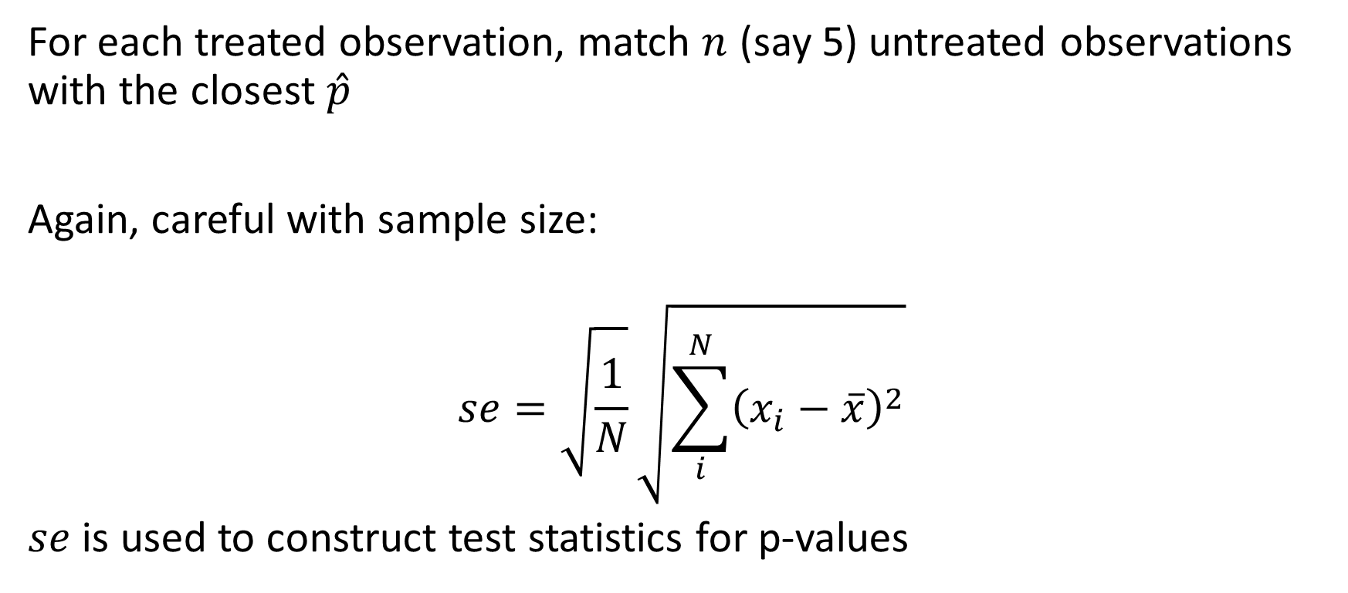
Nearest-Neighbor Propensity Score Matching
For each treated observation, match $n$ (say 5) untreated observations with the closest $\hat{p}$
Again, careful with sample size:
$$se=\sqrt{\frac{1}{N}}\sqrt{\sum_{i}^{N}{{\left(x_{i}−\overline{x}\right)}^{2}}}$$
$se$ is used to construct test statistics for p-values

Slide 12
Coding Example: Lalonde (1986)
National Supported Work Demonstration (NSW) job-training program
1970s: program admitted
Women receiving Aid to Families with Dependent Children
Recovering addicts
Released offenders
Men and women of both sexes who had not completed high school
Lalonde (1986) used observational data as control group
Control group relative to treated group
Smaller proportion black and Hispanic, older, more likely married, higher educated, higher earnings, higher levels of employment
Cringe….

Slide 13
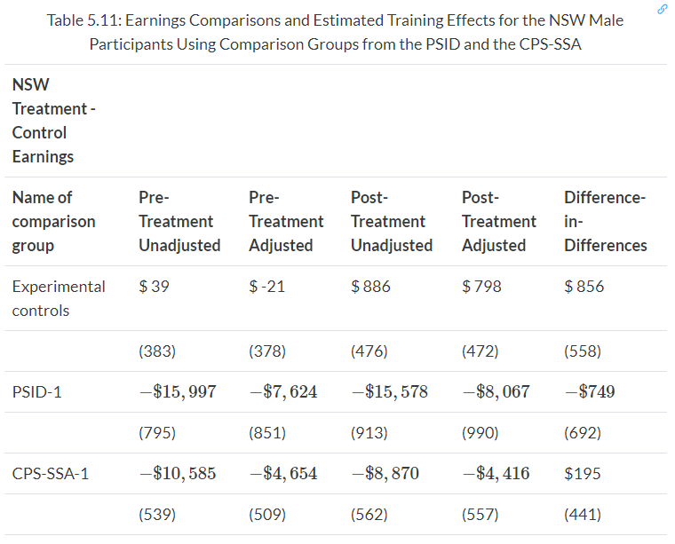

Coding Example: Lalonde (1986)
$←$ estimates are all over the place
Selection bias
Can we fix it?

Slide 14
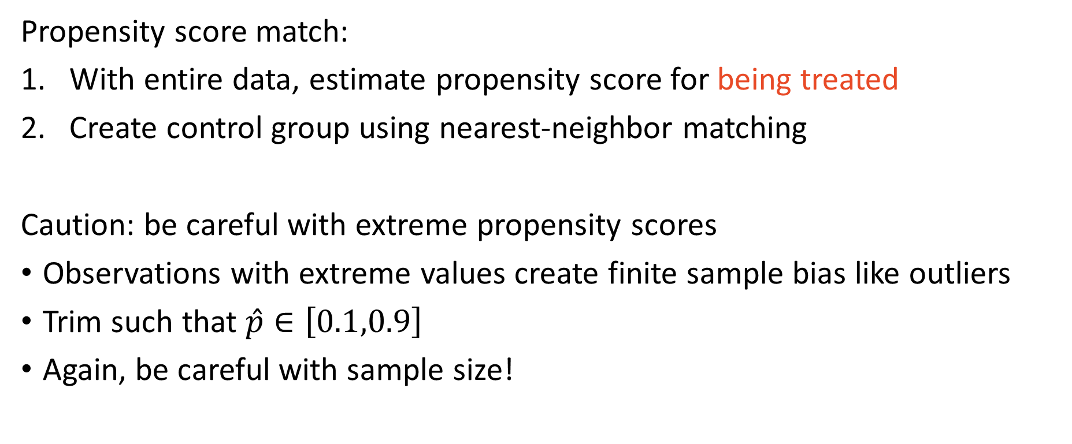
Empirical Approach
Propensity score match:
With entire data, estimate propensity score for being treated
Create control group using nearest-neighbor matching
Caution: be careful with extreme propensity scores
Observations with extreme values create finite sample bias like outliers
Trim such that $\hat{p}∈\left[0.1,0.9\right]$
Again, be careful with sample size!

